Slide 1
Python environment install
Icrios– python crash course

Slide 2
Course outcomes:
Be able to understand the potential of Python;
Be able to copy & edit Python programs for your own use;
Make some prototypes application;
Be able to interact with programmers / data scientists;
To be become a proficient python programmer is NOT an objective of this course.

Slide 3
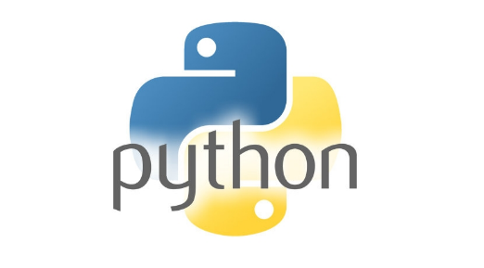



Installing Python
Python programming environments comes with 2 major releases :2.X and 3.X;
Environments have to be enriched with libraries that add tools not included in basic instructions set;
A complete environment (WIN) needs:
- a distributions & libraries manager (Anaconda)
- a debugger (Pycharm)
- library compilers (VS2017)
- code sharing tools (Jupyter notebook)

Slide 4

Step 0: Installing Anaconda
This is a Python distribution that allows easy management of packages (via Conda system)
Anaconda allows to create several environments with different distributions.
Suggestion: Download the 3.X version for your OS from here
https://www.anaconda.com/distribution/#download-section

Slide 5
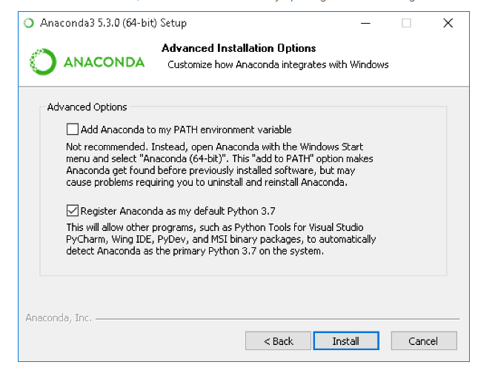
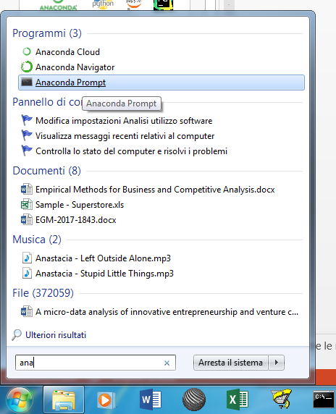
Step 0: Installing Anaconda
Run the installation file and follow the instructions
Complete instructions for installing Anaconda, here:
https://docs.anaconda.com/anaconda/install/windows/
Note: if you flag «add anaconda to path», then you will be able to open a command prompt and if you type «conda» the command will be recognized.
If you do not flag this box, in order to execute «conda» instructions you will have, after installation, to open an «anaconda prompt» from the start menu

Slide 6
Step 1: Create a Python env
Create a Python environment in this way
Open a command prompt (or an «anaconda prompt»)
Type conda create –n myenv python=3.7
replace myenv with any name of your choice for your environment (e.g. py3)
Complete instructions for creating and managing Anaconda environments, here:
https://conda.io/projects/conda/en/latest/user-guide/tasks/manage-environments.html

Slide 7
Step 2: install packages
Install some packages in the new environment (further packages can be installed in a similar way)
Open a command prompt (or an «anaconda prompt»)
Type conda activate myenv (if you used a different name type something like conda activate pitone3)
Install pandas package by typying:
conda install -c anaconda pandas
Install numpy package by typying:
conda install -c anaconda numpy
Follow the same procedure to install any other package. If you are unsure about how to install a package, just google «conda install package_name»

Slide 8
Step 3: Installing a debugger
Suggested: Pycharm community ediction
https://www.jetbrains.com/pycharm/download/#section=windows
Just execute the installation file and follow instructions. Complete installation instructions, here:
https://www.jetbrains.com/help/pycharm/install-and-set-up-pycharm.html

Slide 9
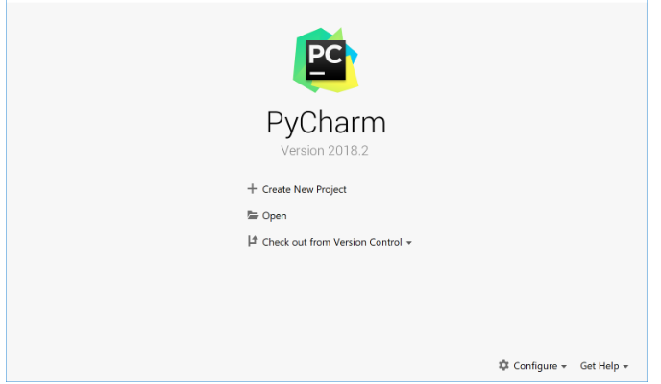
Step 3: Installing a debugger
The first time you launch the programme after installation, you will be presented a screen like this:
Click on create a new project. Select the folder where you want the new project to be created.

Slide 10


Step 1: Installing a debugger
Suggested: pycharm community ediction
https://www.jetbrains.com/pycharm/download/#section=windows
Each time you run a program in Pycharm you need to configure python interpreter
To add modules / finetuning of one environment: File + settings (ctrl + alt + S)
To make available existing distributions / environments
Select show all, next window press + and add environments you made

Slide 11

Step 2: install a compiler
[WIN ONLY] This helps to locally compile new modules
https://visualstudio.microsoft.com/it/vs/features/cplusplus/
Install VS2017 – visual studio 2017
Some environments might require older versions (PY35 → VC++ 14 → VS 2015)

Slide 12
Step 3: Jupyter Notebooks
Jupiter is a code sharing tool
You can run from anaconda apps but you cannot control path
Otherwise:
python -m pip install --upgrade pip
python -m pip install jupyter
To run jupiter Create a small bat file as:
set PATH=C:\python36\Scripts;%PATH%
cd d:\
d:
jupyter notebook

Slide 13
Step 4: Course download
All notebooks and dataset of the course are available on github repository:
https://bit.ly/2VnW8yl
To make it available to jupiter download them under you Documents folder

Slide 14
Thank You
Kingsoft Office
Make Presentation much more fun

